Slide 1


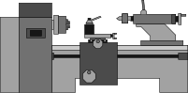

DESIGN OF MACHINE ELEMENTS
Manual Lathe Machine
Carriage Guideway & Leaad Screw Design
Sonal(B22ME062) Yogesh(B22ME073)

Slide 2

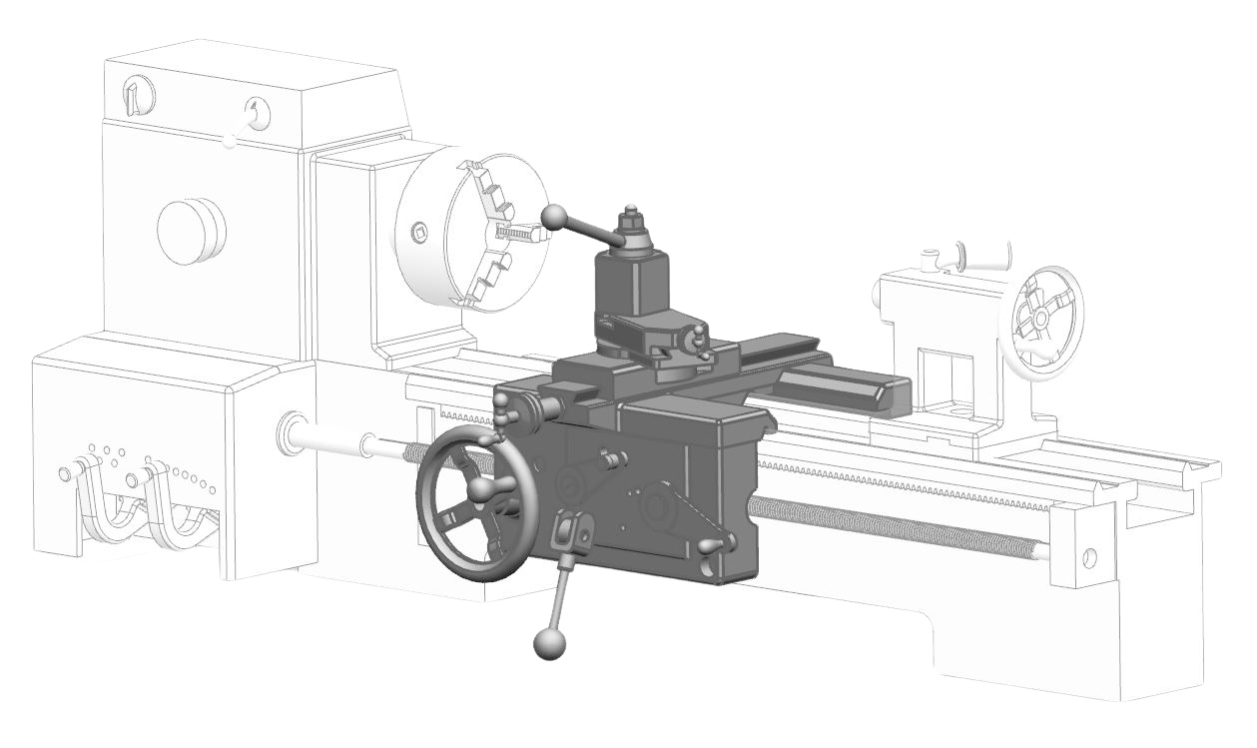
INTRODUCTION
The carriage is a major part of the lathe machine that supports and moves the cutting tool along the bed. It enables precise longitudinal and cross-feed motion during machining operations like turning, facing, and threading.
Holds and moves the cutting tool accurately
Enables smooth machining along the length of the workpiece
Supports tool post and cross-slide mechanisms

Slide 3

MATERIAL SELECTION
Guideways & Carriage – FG260 (High-Grade Cast Iron):
FG260 has higher hardness and improved wear resistance
Its excellent self-lubricating and damping properties help reduce friction and absorb vibrations during carriage movement.
Leadscrew – ANSI 1045 (Medium Carbon Steel): ANSI 1045 steel offers high tensile strength and good machinability, ideal for handling axial loads in the screw mechanism.
Bed – FG200 (Gray Cast Iron): Its good castability and compressive strength make it ideal for the rigid and stable base structure of the lathe.
Tool Holder – Cast Alloy Steel: Cast alloy steel offers high toughness and wear resistance, making it suitable to withstand cutting forces and shocks.
Tool – HSS (High-Speed Steel): HSS retains hardness at elevated temperatures, ideal for cutting operations at high speeds.

Slide 4
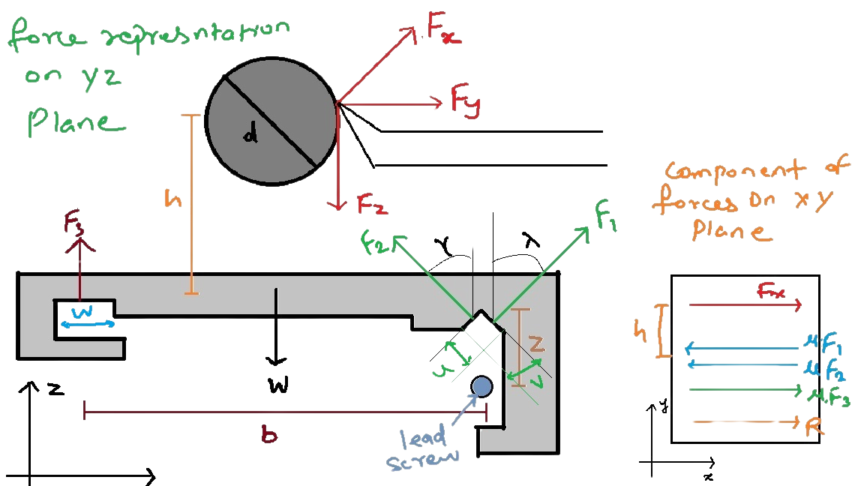
FORCES
REPRESENTATION

Slide 5
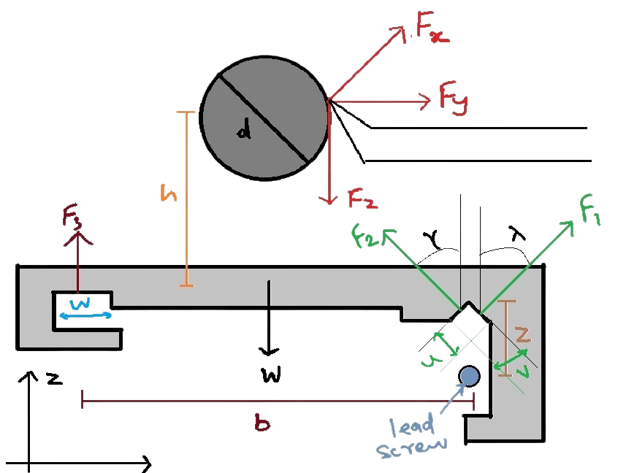
NOMENCLATURE OF FORCES & DISTANCES
F1 : Normal Force at one V surface of carriage
F2 : Normal Force at other V surface of carrriage
F3 : Normal Force at flat surface carriage
FX : X component of cutting force at tool and workpiece interface
FY : Y component of cutting force at tool and workpiece interface
FZ : Z component of cutting force at tool and workpiece interface
R : Pushing force of carriage
μF1 : Friction force due to force F1
μF2 : Friction force due to force F2
μF3: Friction force due to force F3
W : Force due to weight of the carriage
d : diameter of the workpiece
h : vertical distance between center of workpiece and carriage surface
b : horizontal distance between flat and V shape surface
Z : vertical distance between V shape and lead Screw
u,v,w : Length of contact

Slide 6

ASSUMPTIONS
All dimensions are taken with reference of Manual Lathe Machine present in IIT Jodhpur Centeral Workshop
Fx, Fy, Fz are general assumed cutting forces
Weight of Carriage : 200 Kg
Cutting Forces:
Fx : 500 N
Fy : 800 N
Fz : 4000 N
b (distance between guideways) = 0.12 m
h (distance between workpiece & guideway) : 0.13 m
d (WorkPiece Diameter) = 0.03 m
Friction Coeff = 0.1
R (Pushing force) = 50 N
L (Carriage Lenght) = 0.15 m
contact Angle(V) = 45 deg

Slide 7

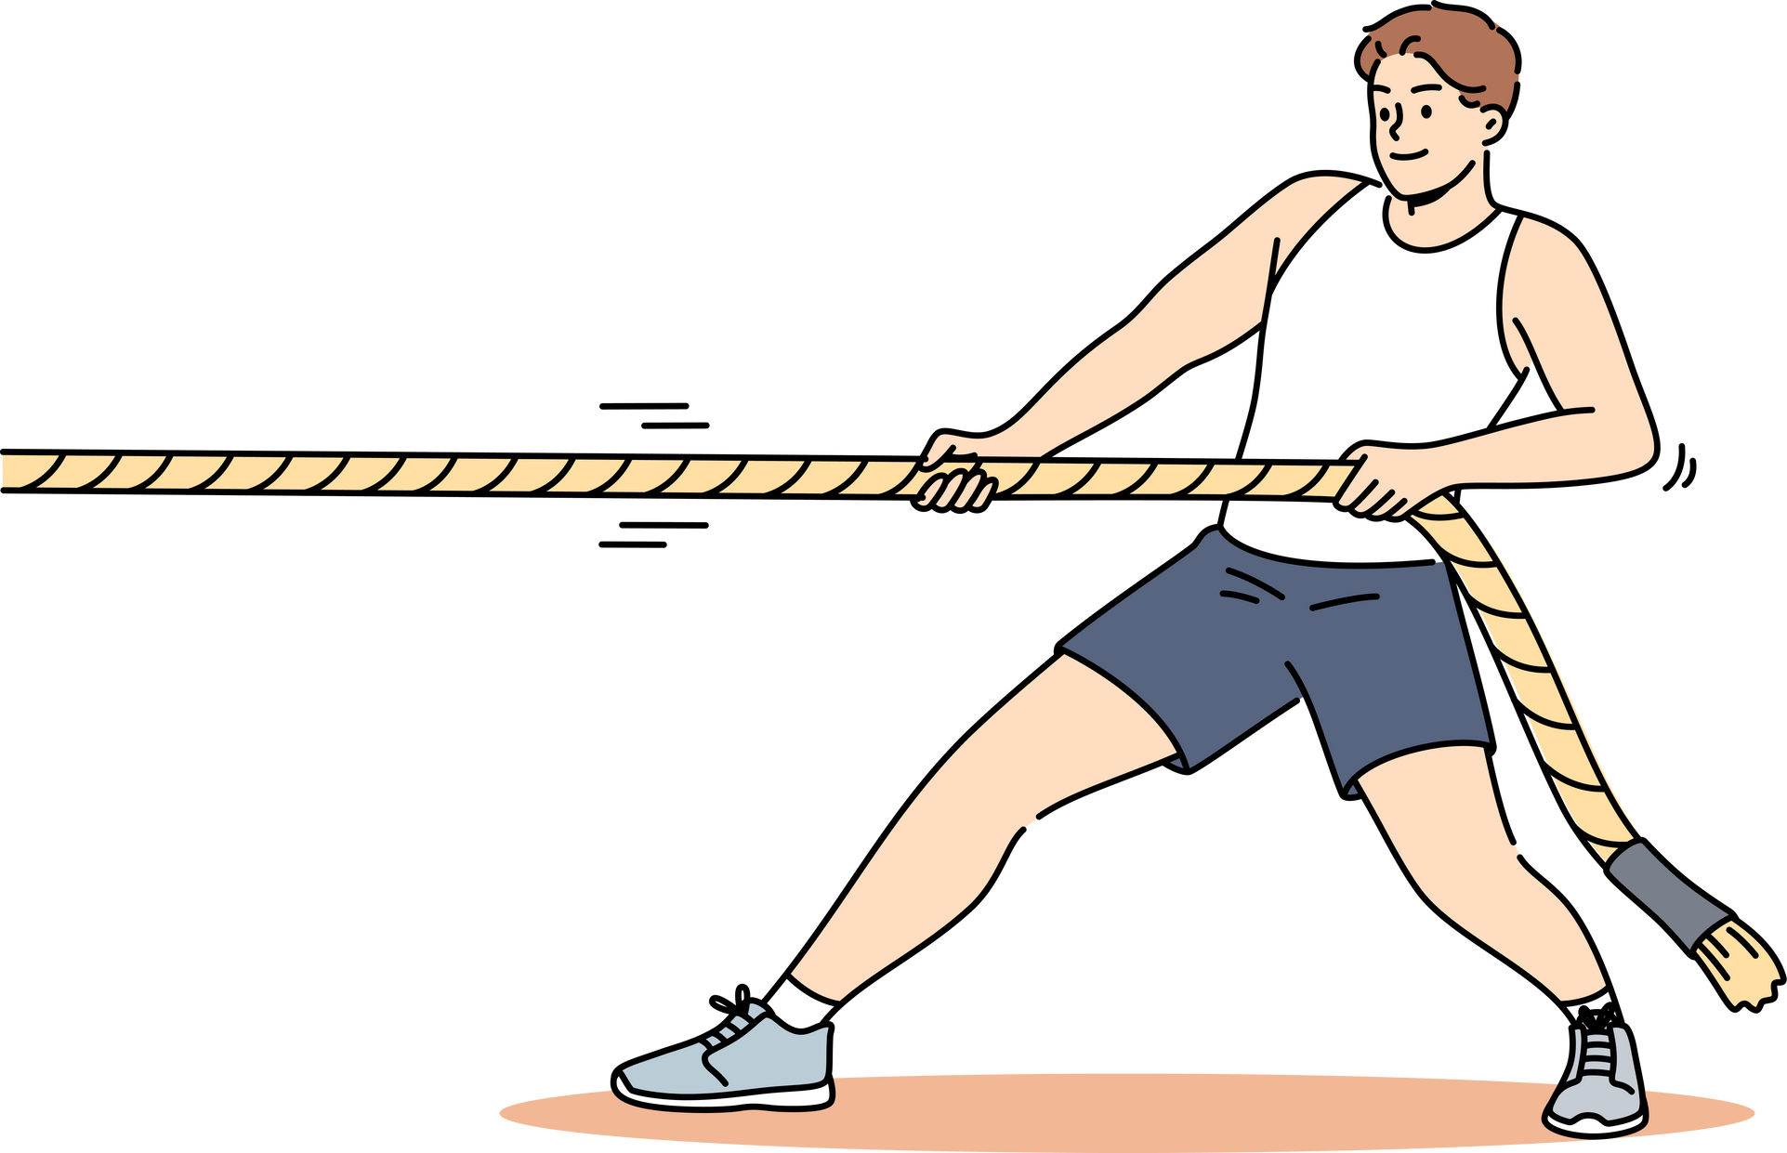
PART - 1
CALCULATION UNDER STATIC LOADS CONSIDERING MAXIMUM NORMAL STRESS
THEORY

Slide 8
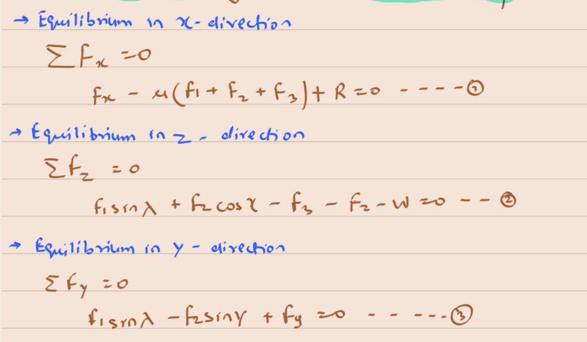
DERIVATION OF EQUTIONS NORMAL STRESS

Slide 9
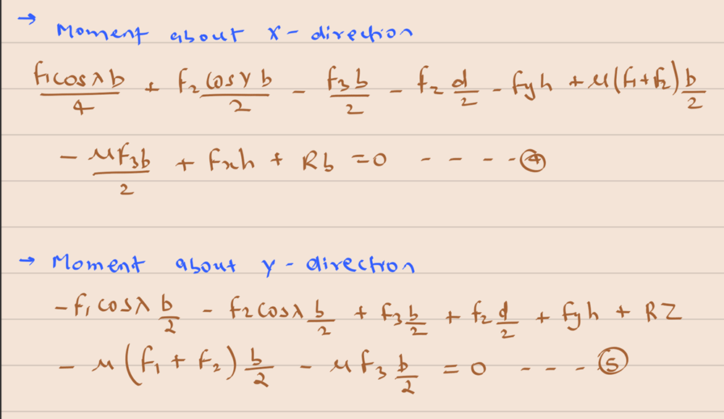
DERIVATION OF EQUTIONS NORMAL STRESS

Slide 10
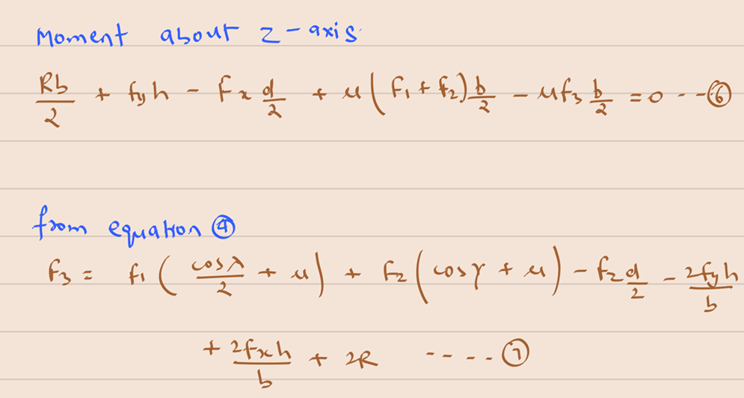
DERIVATION OF EQUTIONS NORMAL STRESS

Slide 11
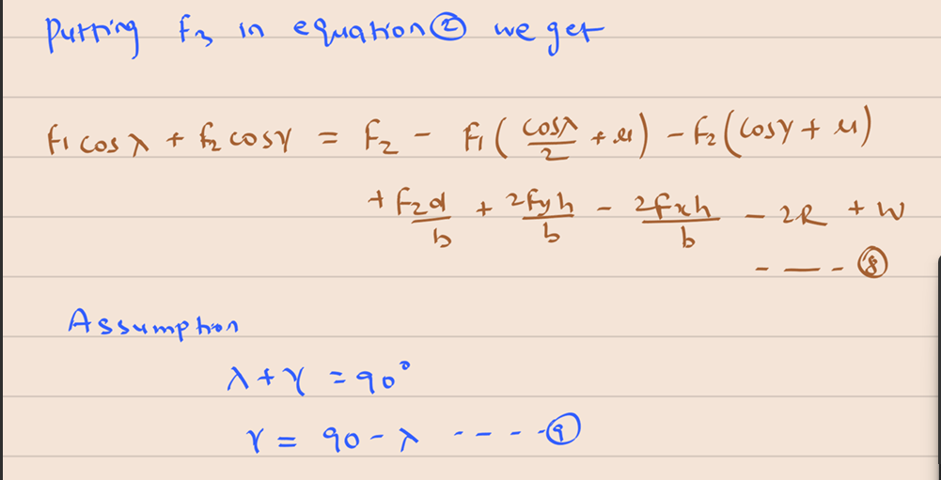
DERIVATION OF EQUTIONS NORMAL STRESS

Slide 12
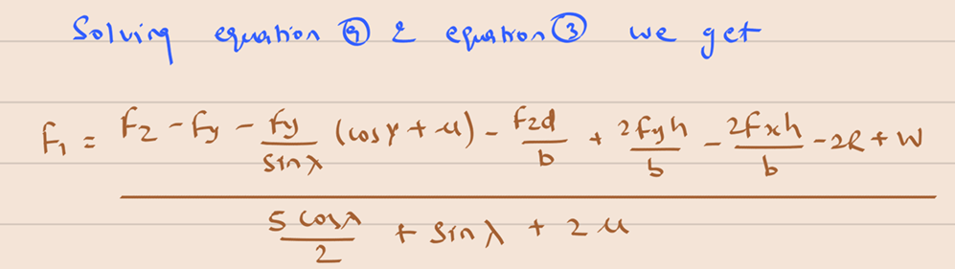
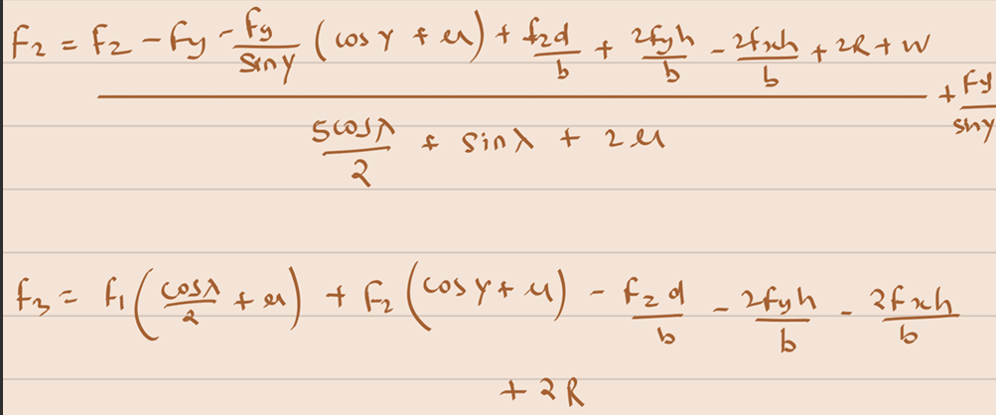
DERIVATION OF EQUTIONS NORMAL STRESS

Slide 13
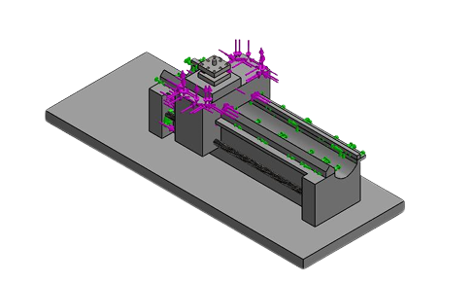
DERIVATION OF EQUTIONS NORMAL STRESS

Slide 14
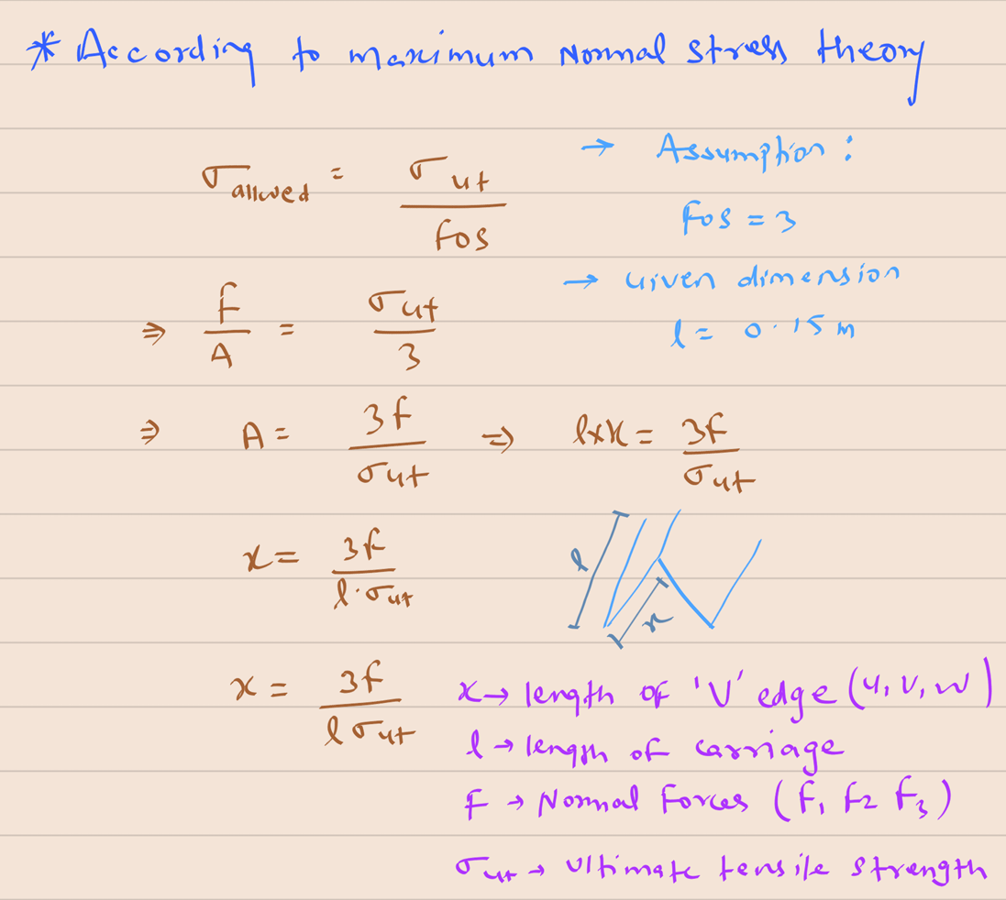

Slide 15

FINAL DIMENSIONS &
FINAL FORCES VALUES
These dimensions are based on Normal Shear Stress Theory
All Calculation are done in Matlab Software
F1 = 2606 N
F2 = 3546 N
F3 = 1613 N
U = 0.029 m = 2.9 cm
V = 0.039 m = 3.9 cm
W = 0.017 m = 1.7 cm

Slide 16
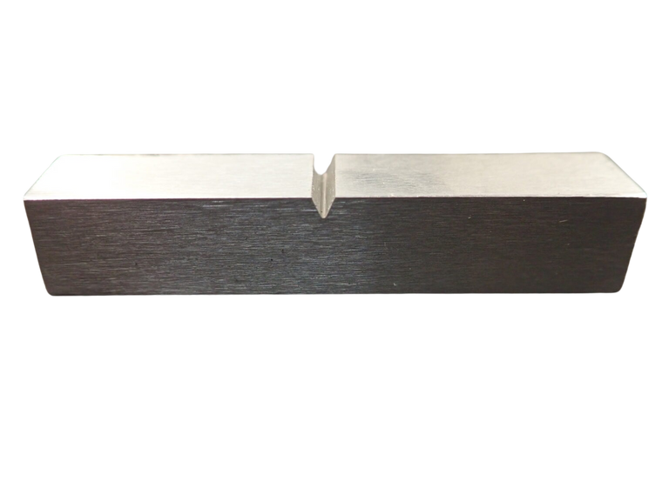
PART - 2
CALCULATION FOR NOTCH SAFETY AT ‘ V ’ JUNCTION OF CARRIAGE & GUIDEWAY MATTING SURFACE

Slide 17
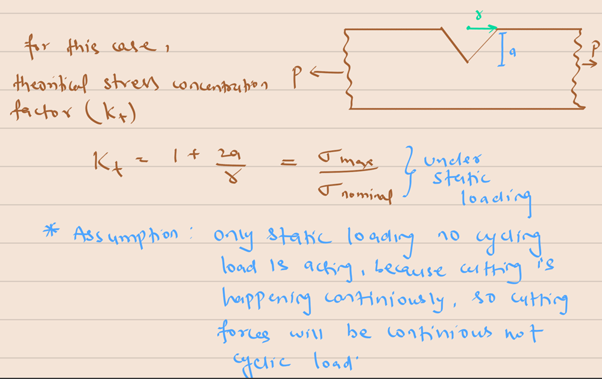
NOTCH SAFERY DERIVATION

Slide 18
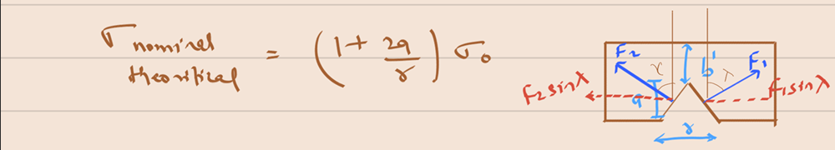
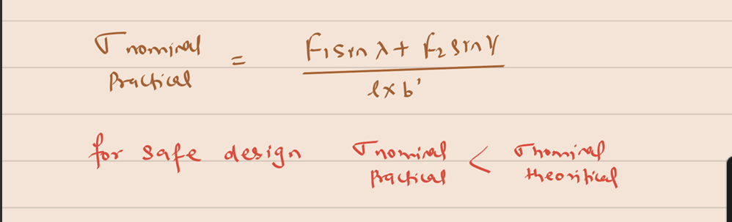

NOTCH SAFERY DERIVATION

Slide 19
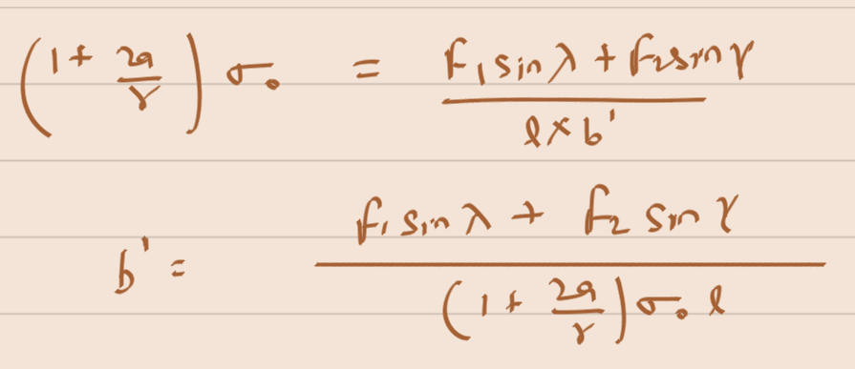
CALCULATION OF HEIGHT AT NOTCH CENTER
For safe design
Sigma Nominal Practical <= Sigma Nominal Theoritical
On Calculating on matlab
b’ = 0.04 m = 4 cm
For to be more safe we have considered (b’ = 5 cm)

Slide 20
PART - 3
CALCULATION FOR NOTCH SAFETY AT ‘ V ’ JUNCTION DUE TO SHEAR

Slide 21
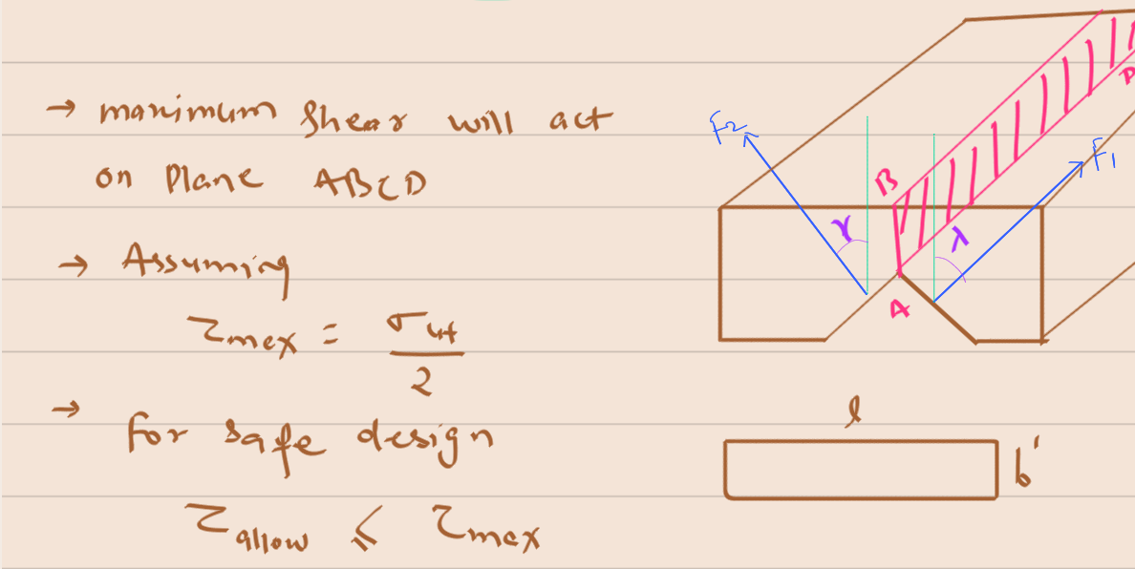
NOTCH SAFERY DERIVATION

Slide 22
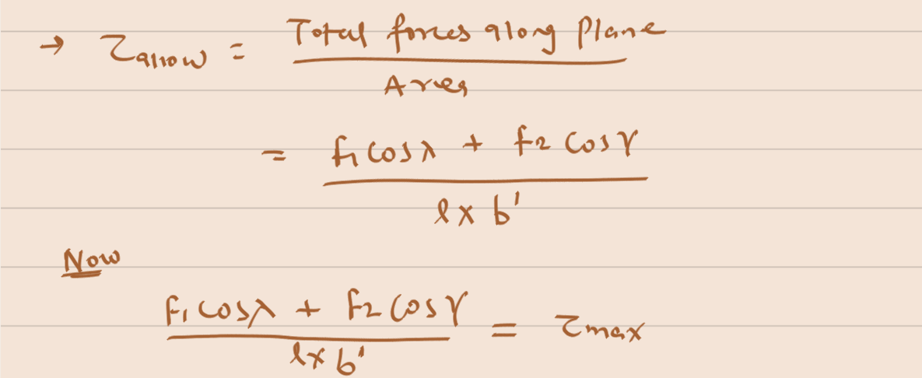
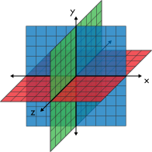
NOTCH SAFERY DERIVATION

Slide 23
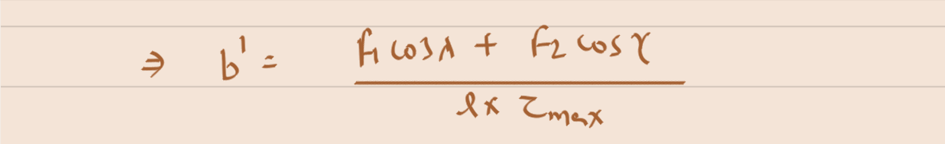
SHEAR SAFERY DERIVATION
On calculation on Matlab
b’ = 0.11 m = 11 cm

Slide 24
COMPRASION OF DIMENSIONS
From Notch sensitivity the dimension of b’ = 0.04 m = 4 cm
From Notch sensitivity for Shear the dimension of b’ = 0.11 m = 11 cm
To make a safe design, consider b’ = 0.11 m = 11 cm

Slide 25
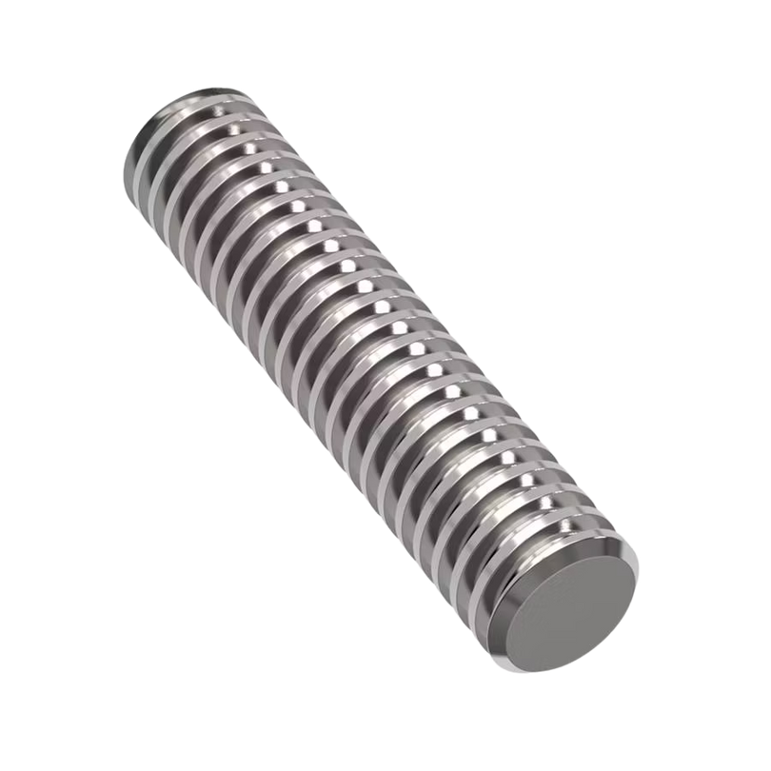
PART - 4
DESIGN OF LEAD SCREW
BUCKLING & TORSION CONSIDERATION

Slide 26
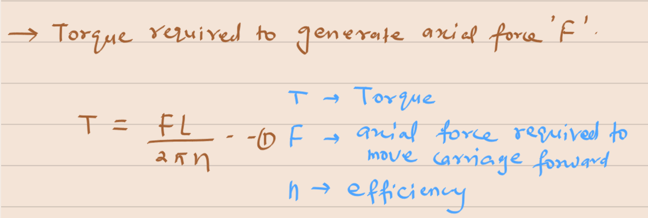
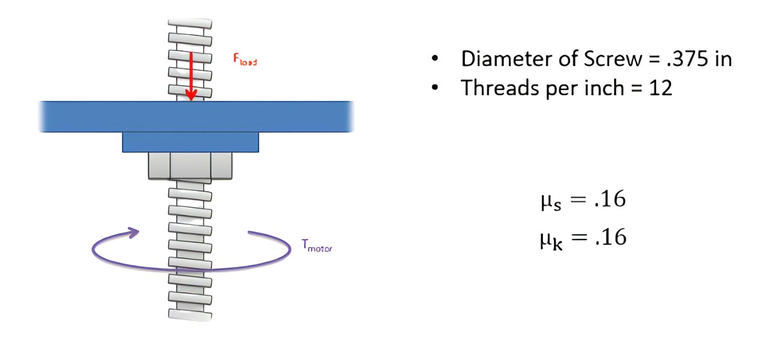
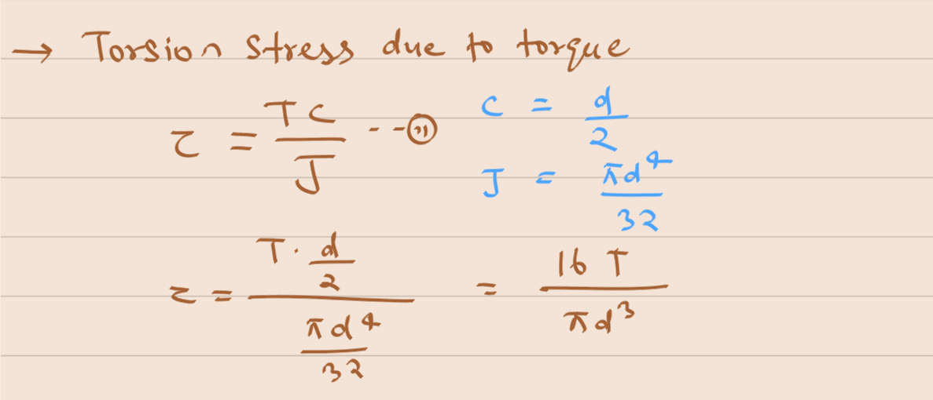
LEAD SCREW (TORSION)

Slide 27
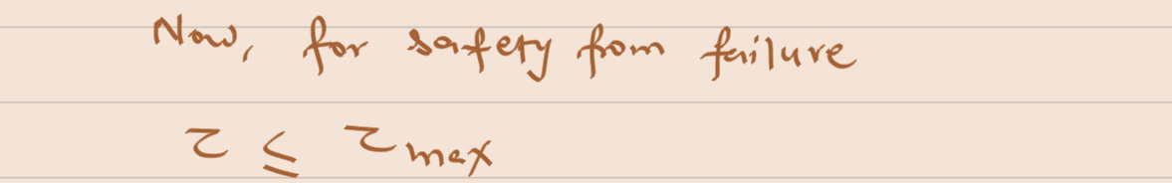
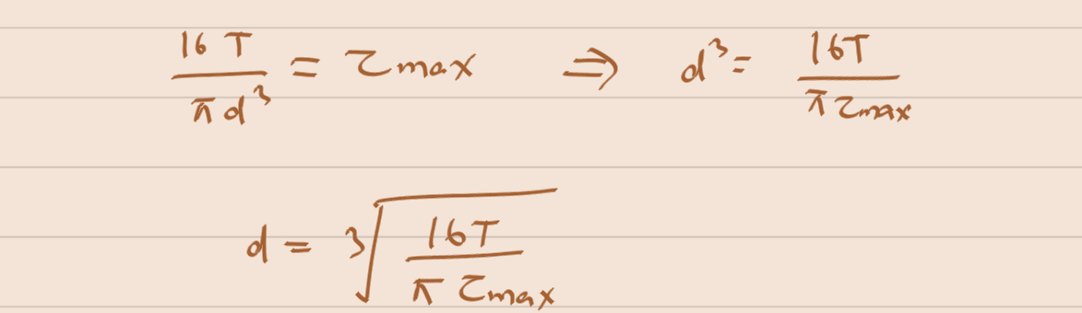
LEAD SCREW (TORSION)

Slide 28
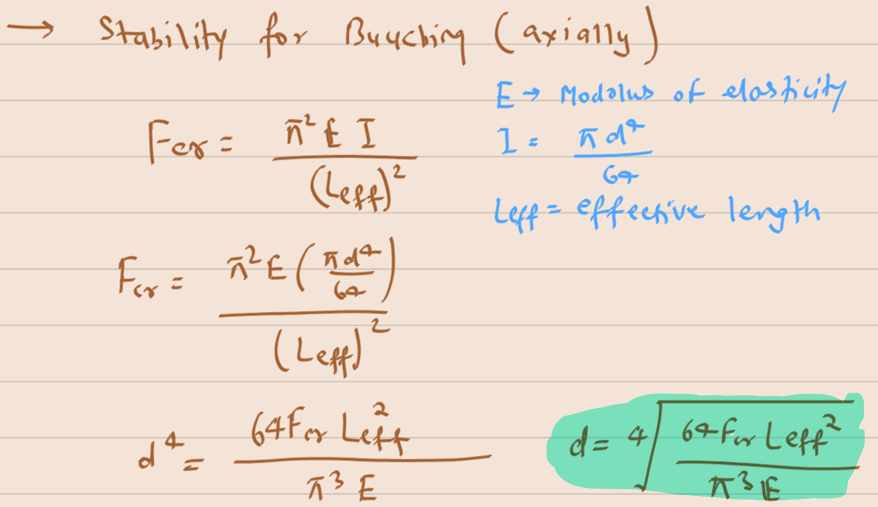
LEAD SCREW (BUCKLING)
Assumption: Forces acting on Y-direction is critical force

Slide 29
DIMENSIONS OF LEAD SCREW
All calculation is done in Matlab
length of Lead Screw = 760 cm (Basic Lab IIT Jodhpur)
diameter (considering torsion) = 7.7 mm
diameter (buckling) = 1.5 cm
diameter(buckling) > diameter(torsion)
Final diameter of lead screw : 2 cm (Considering additional safety)

Slide 30
ANALYSIS OF SOLIDWORKS
OBSERVATIONS

Slide 31
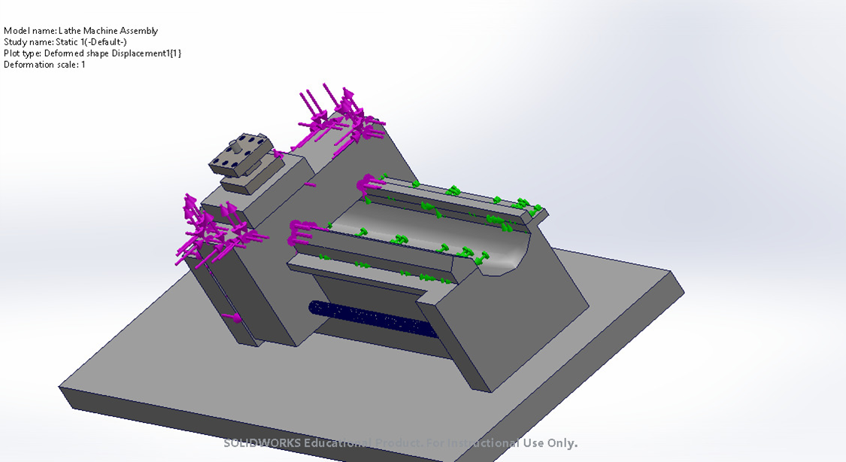
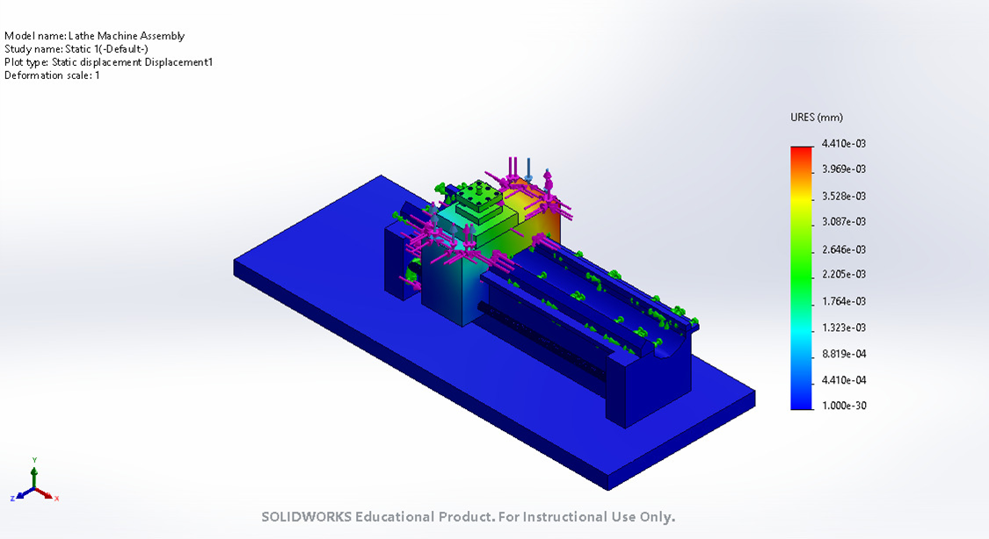
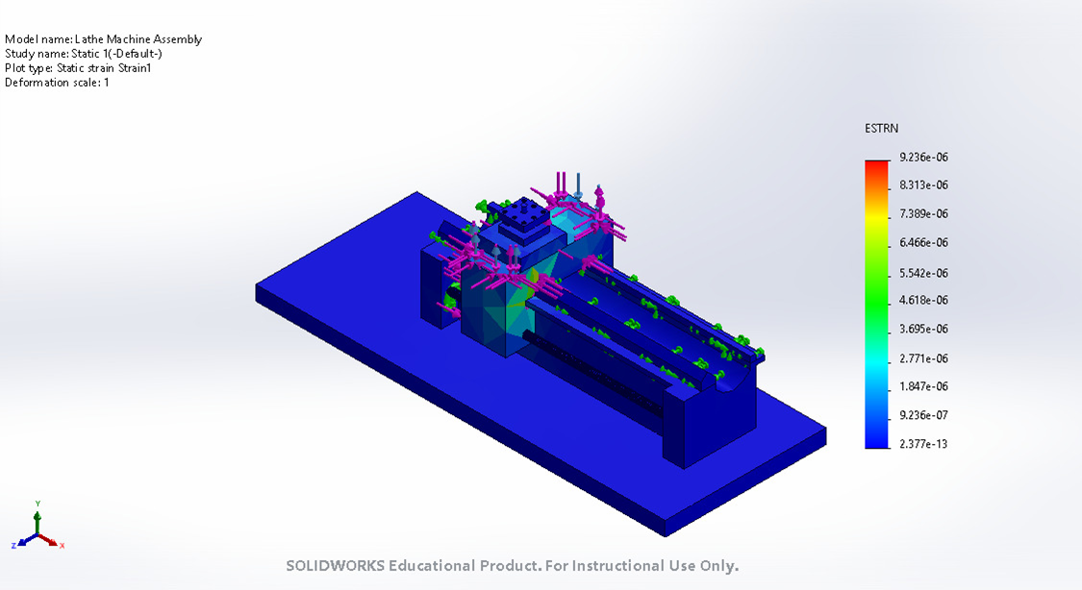


Slide 32
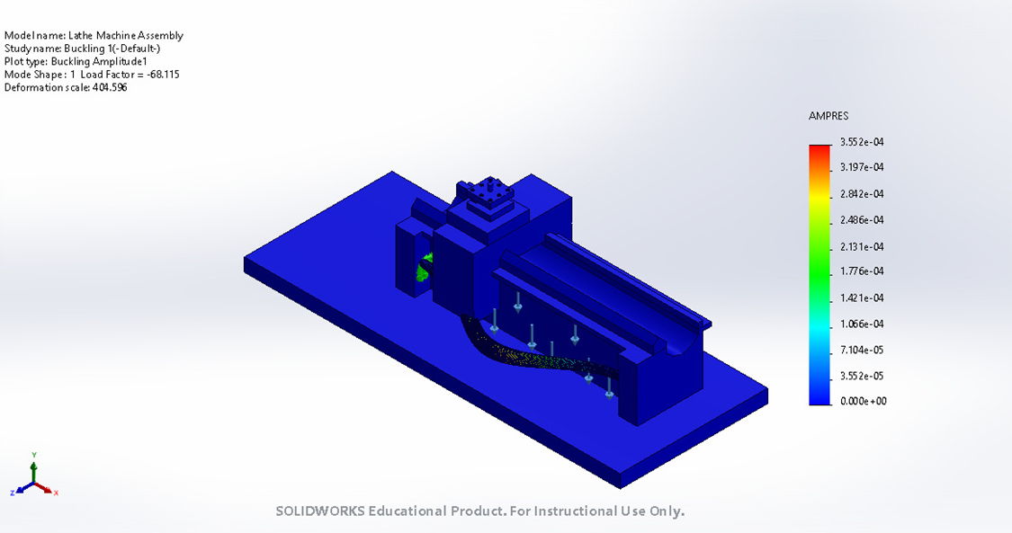
The amplitude of buckling is of order 10^-4 mm, which is very low. So our system is safe buckling also.

Slide 33
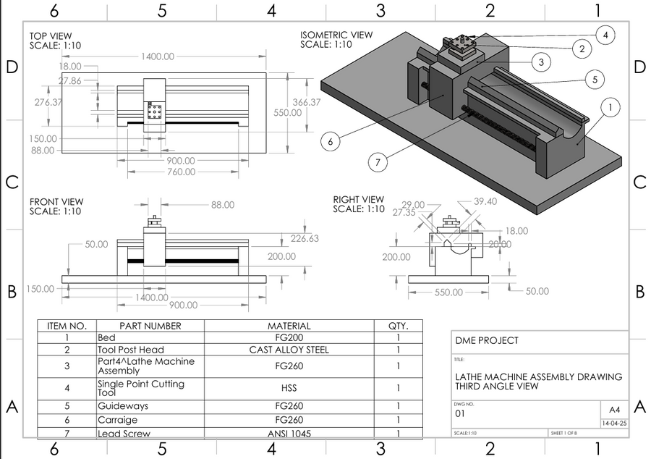
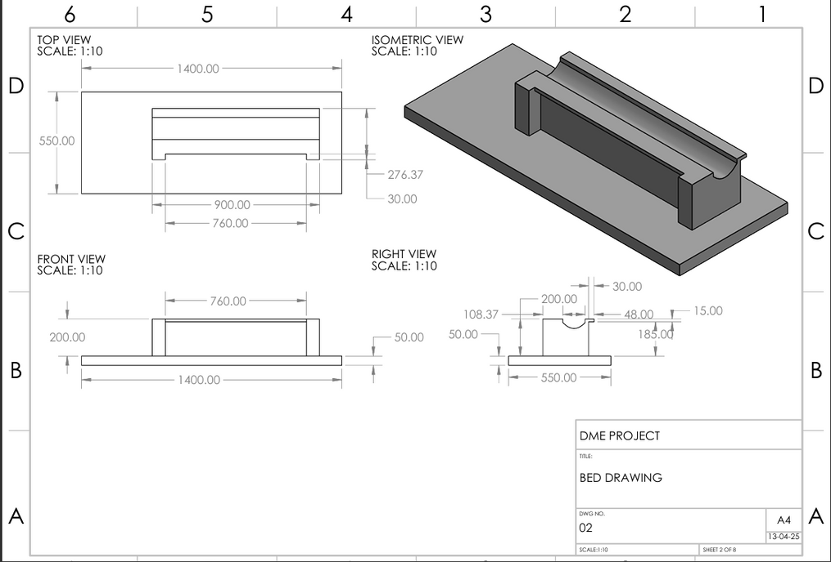
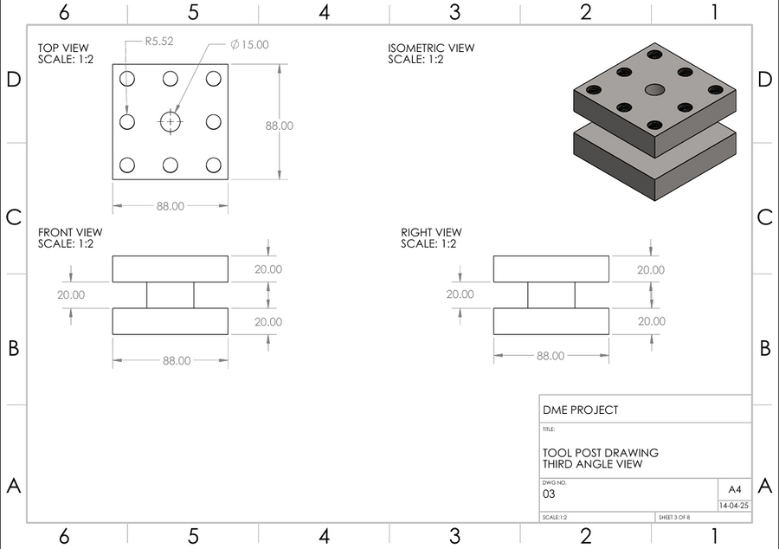
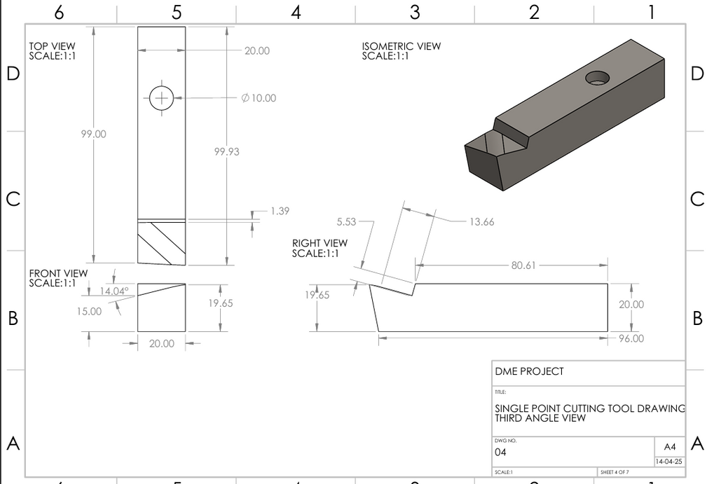
D
R
A
W
I
N
G
S

Slide 34
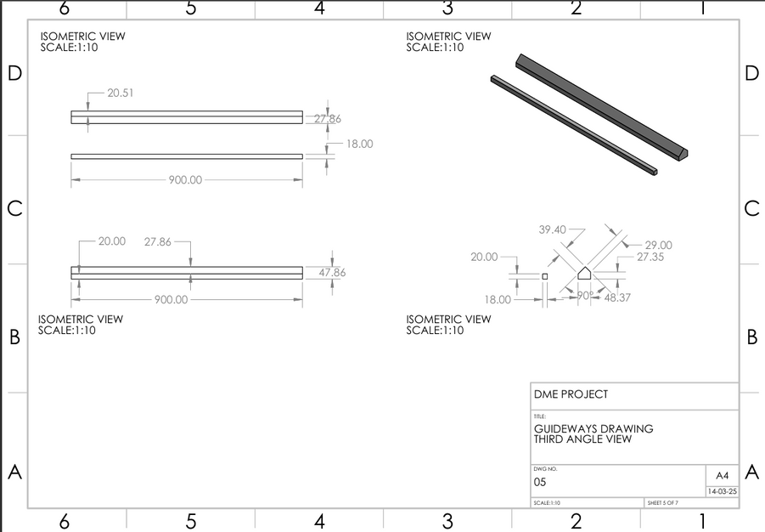
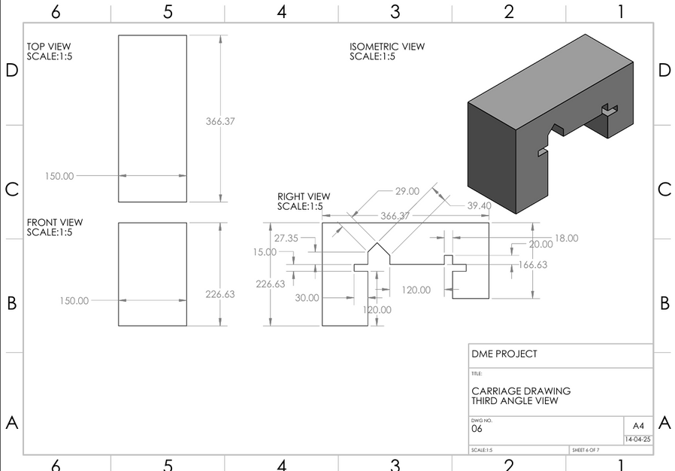
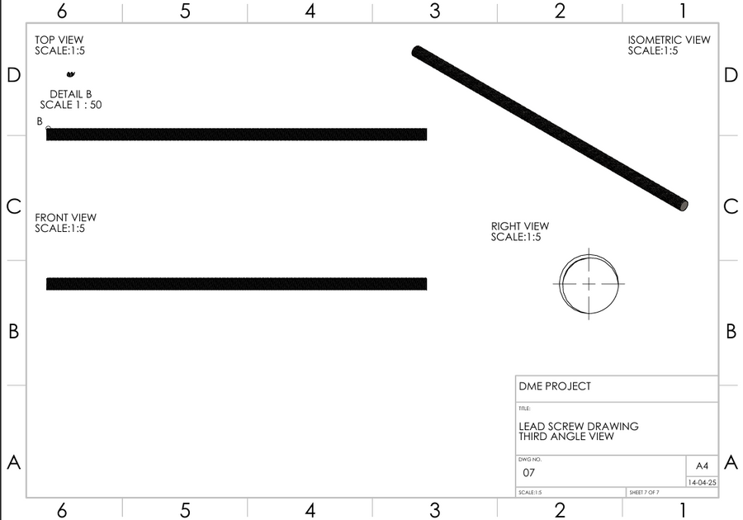

D
R
A
W
I
N
G
S

Slide 35
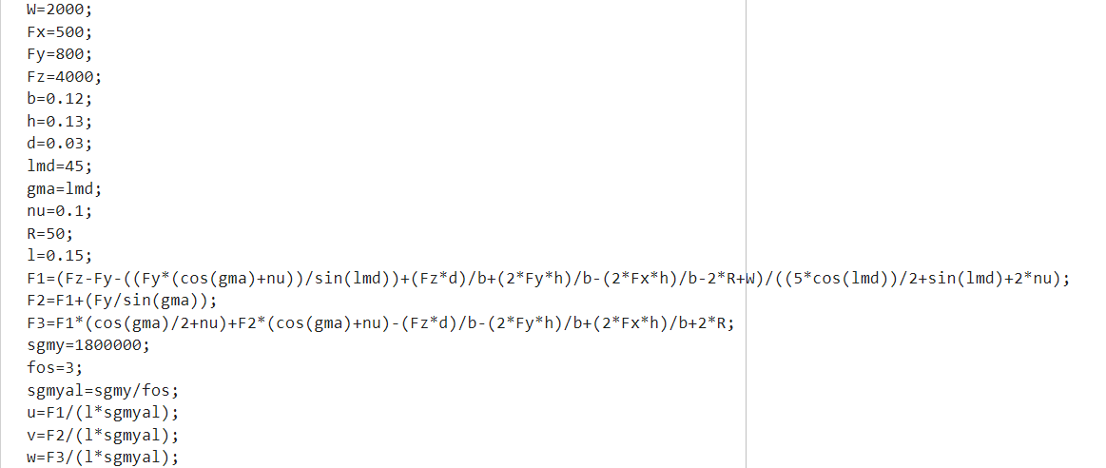
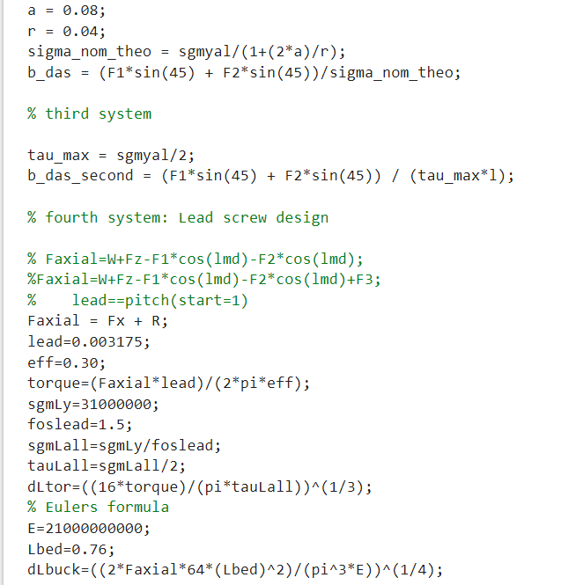
MATLAB CODE

Slide 36
CONTRIBUTIONS
Research and Finding about carriage and Lathe: Sonal & Yogesh
Equlibrium equations in static analysis and Normal force equations:
Force : Yogesh
Moment : Sonal Raj
Notch Sensitivity calculation
Horizantal Component : Sonal Raj
Vertical Component : Yogesh
lead Screw Design (Buckling + Torsion) : Sonal Raj & Yogesh
SolidWorks (Model & Drawing)
Bed, Carriage, LeadScrew : Yogesh
ToolPost, Tool, Guideways : Sonal
Static & Buckling Anlaysis : Sonal & Yogesh

Slide 37
THANK YOU

